Slide 1


University College of Engineering,
Osmania University
Department of Biomedical Engineering
Mini Project Presentation
Guided By :-
Assistant Prof. M. Srinivas
Submitted By:-
Annimalla Manaswini (100519731003)
K Lahari Reddy (100519731013)

Slide 2
PREDICTING THE RISK OF DEVELOPING DIABETIC RETINOPATHY USING DEEP LEARNING

Slide 3
Contents:-
Introduction
Literature review
Requirements
System architecture
Data flow diagram
Sequence diagram
Collaboration diagram
Results
Conclusion
References

Slide 4
Introduction:-
People with diabetes can have an eye disease called diabetic retinopathy. This is when high blood sugar levels cause damage to blood vessels in the retina. These blood vessels can swell and leak. Or they can close, stopping blood from passing through. Sometimes abnormal new blood vessels grow on the retina. All of these changes can steal your vision.

Slide 5
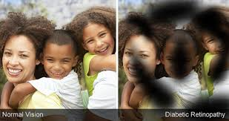
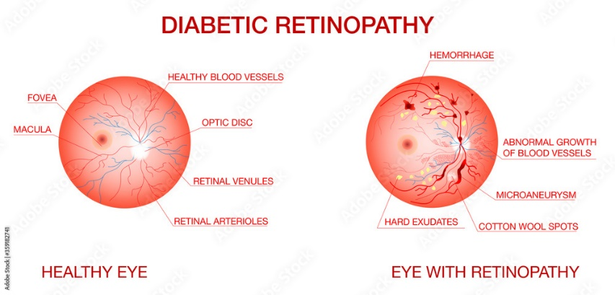

Slide 6
You can have diabetic retinopathy and not know it. This is because it often has no symptoms in its early stages. As diabetic retinopathy gets worse, you will notice symptoms such as:
seeing an increasing number of floaters,
having blurry vision,
having vision that changes sometimes from blurry to clear,
seeing blank or dark areas in your field of vision,
having poor night vision, and
noticing colours appear faded or washed out
losing vision.

Slide 7
Literature review:-
Automatic Diabetic Retinopathy Detection and Classification System
Z. A. Omar, M. Hanafi, S. Mashohor, N. F. M.Mahfudz - october 2017
Methodology :-
DR detection was performed by utilizing characteristics of DR features such as intensity values shape and size.
The stages used in the proposed detection algorithm are image pre-processing, blood vessels and hemorrhages detection, optic disc removal and exudates detection
Results :-
Based on our observation, the total number of detected vessels and hemorrhages, and exudates are 87 and 89, respectively. Hence the percentages of detection for vessels and hemorrhages, and exudates are 98% and 100%, respectively.
Disadvantages :-
The proposed system is reliable and the implementation of the proposed system could tackle the limitation of the manual screening process.

Slide 8
Literature review:-
A Survey on Diabetic Retinopathy Disease Detection and Classification using Deep Learning Techniques
Vijayabhanu R, Valarmathi
Methodology :-
Convolutional Neural Networks (CNNs) Deep Learning plays a dominant role in classifying, localizing, segmenting and detecting medical images.
Results :-
CNNs have been used for its ability to provide more potential results and its efficiency, which outperform the other methods.
Disadvantages :-
More work to be done on this part to overcome all the drawbacks and to improve performance of the system.

Slide 9
Requirements:-
SOFTWARE REQUIREMENTS -
The functional requirements or the overall description documents include the product perspective and features, operating system and operating environment, graphics requirements, design constraints and user documentation.
The appropriation of requirements and implementation constraints gives the general overview of the project in regards to what the areas of strength and deficit are and how to tackle them.
Python idel 3.7 version (or)
Anaconda 3.7 ( or)
Jupiter (or)
Google colab

Slide 10
Requirements:-
HARDWARE REQUIREMENTS -
Minimum hardware requirements are very dependent on the particular software being developed by a given Enthought Python / Canopy / VS Code user. Applications that need to store large arrays/objects in memory will require more RAM, whereas applications that need to perform numerous calculations or tasks more quickly will require a faster processor.
Operating system : windows, linux
Processor : minimum intel i3
Ram : minimum 4 gb
Hard disk : minimum 250gb

Slide 11
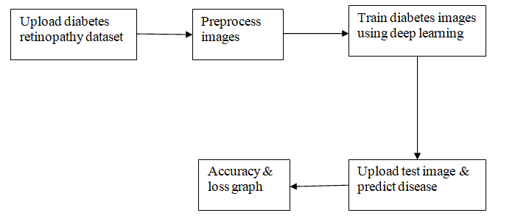
System Architecture:-

Slide 12




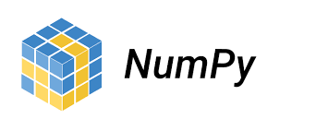

Software architecture:

Slide 13
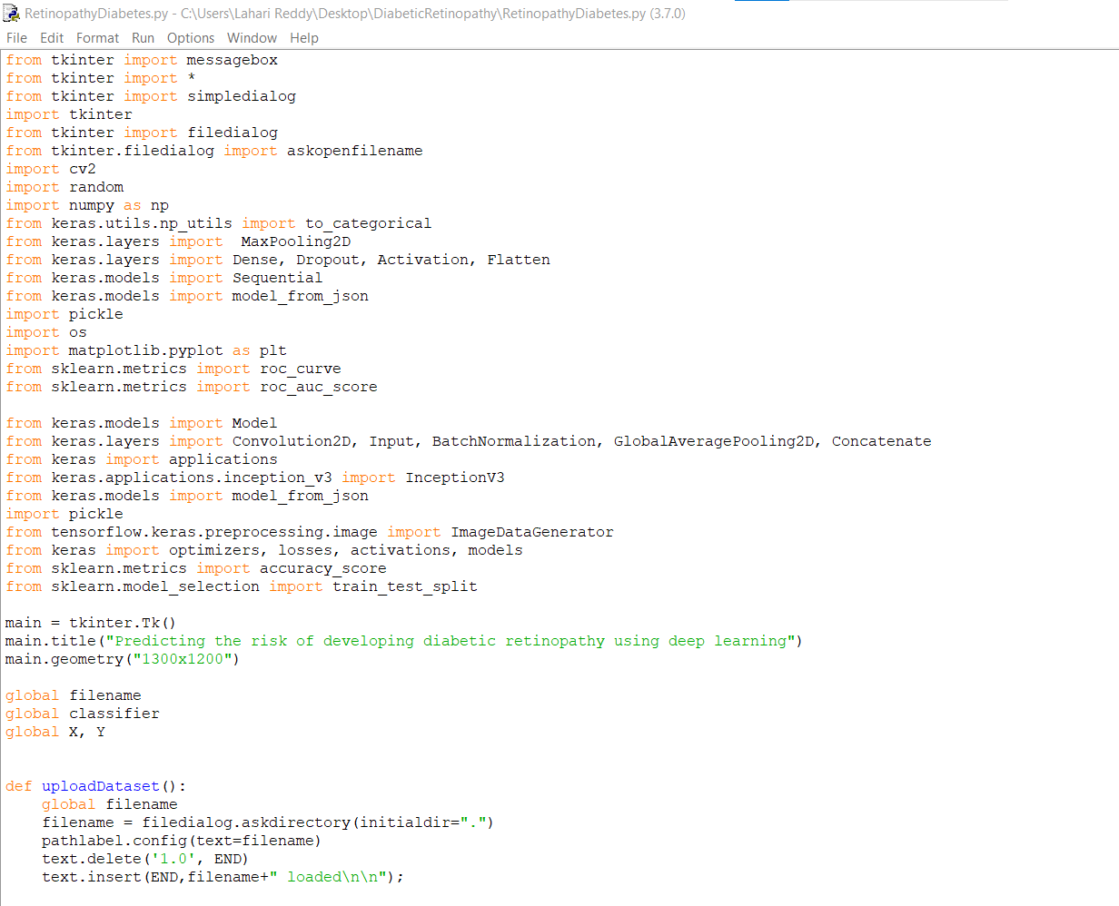

Slide 14
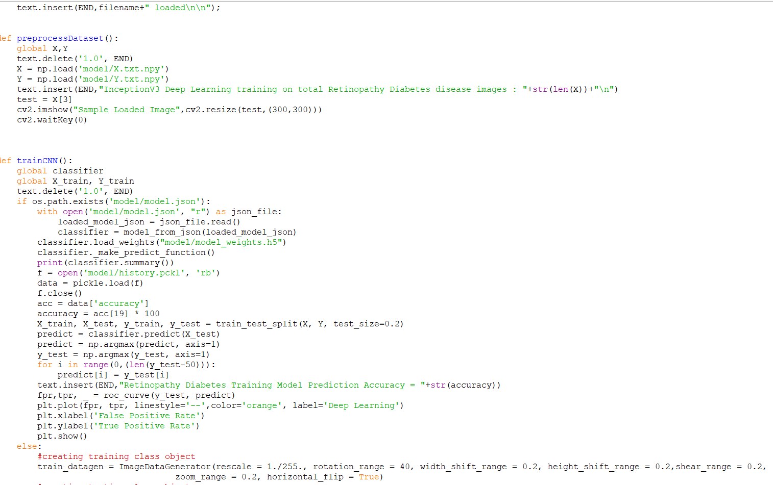

Slide 15
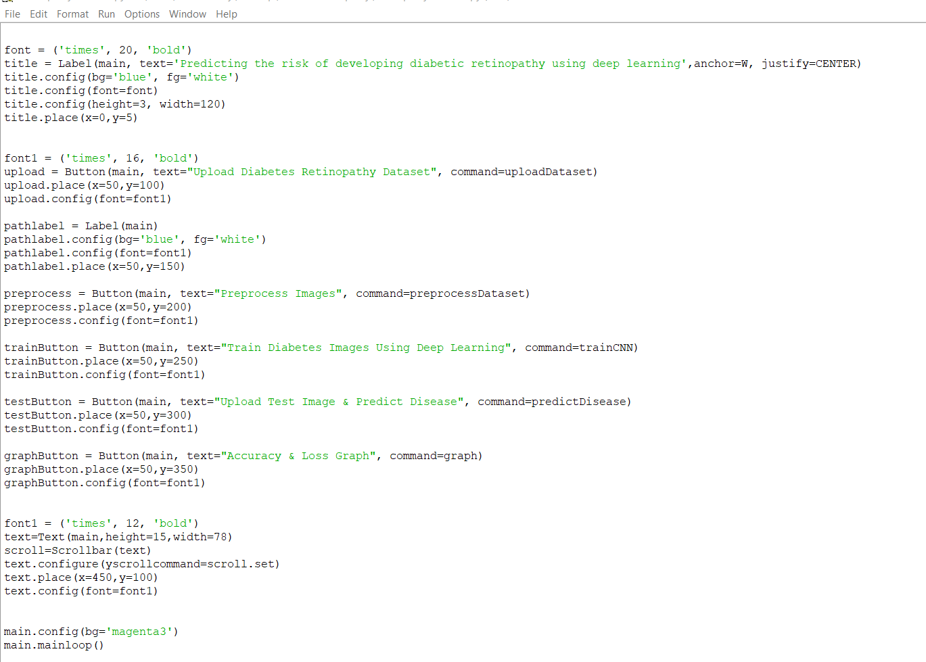

Slide 16
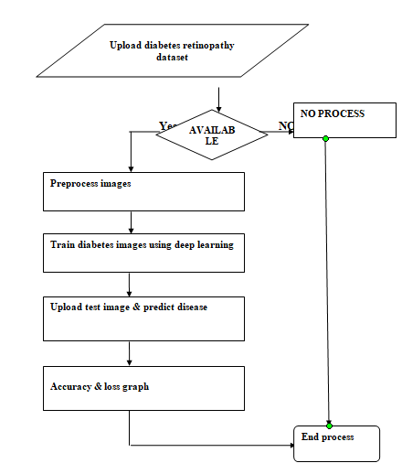
Dataflow diagrams:-

Slide 17
Sequence diagram:-

Slide 18
Collaboration diagram:-

Slide 19
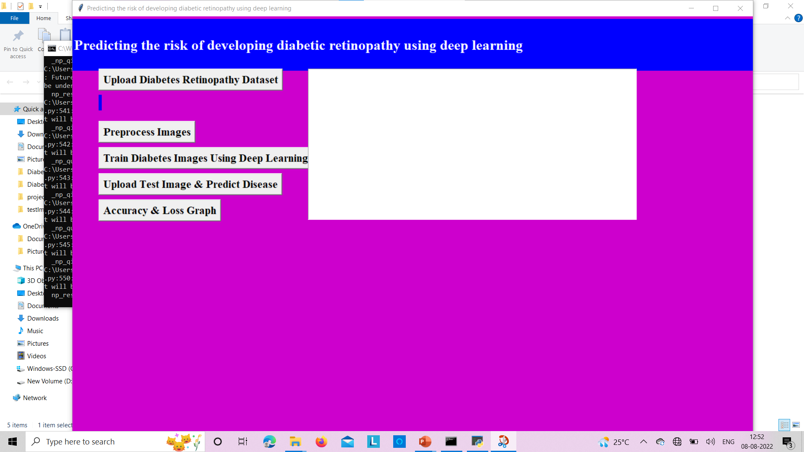
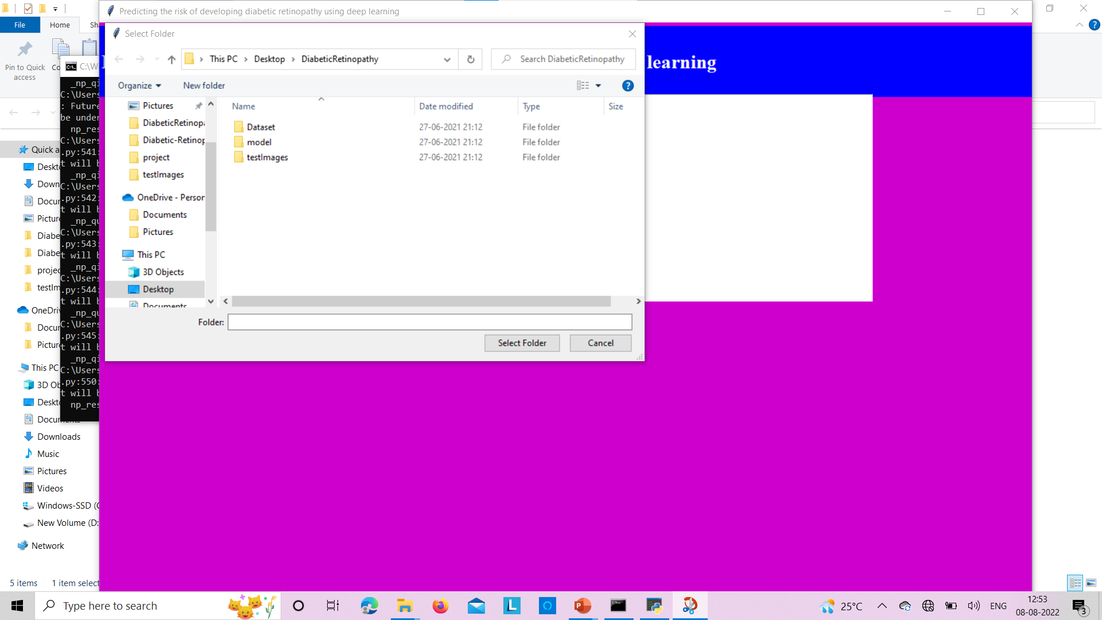
Results:

Slide 20
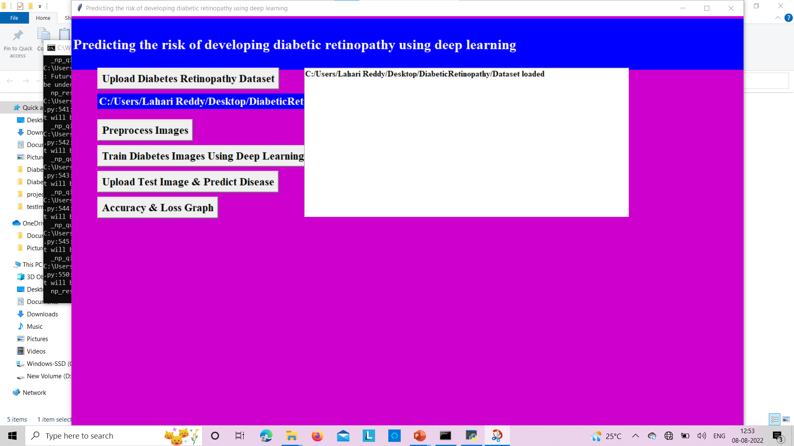
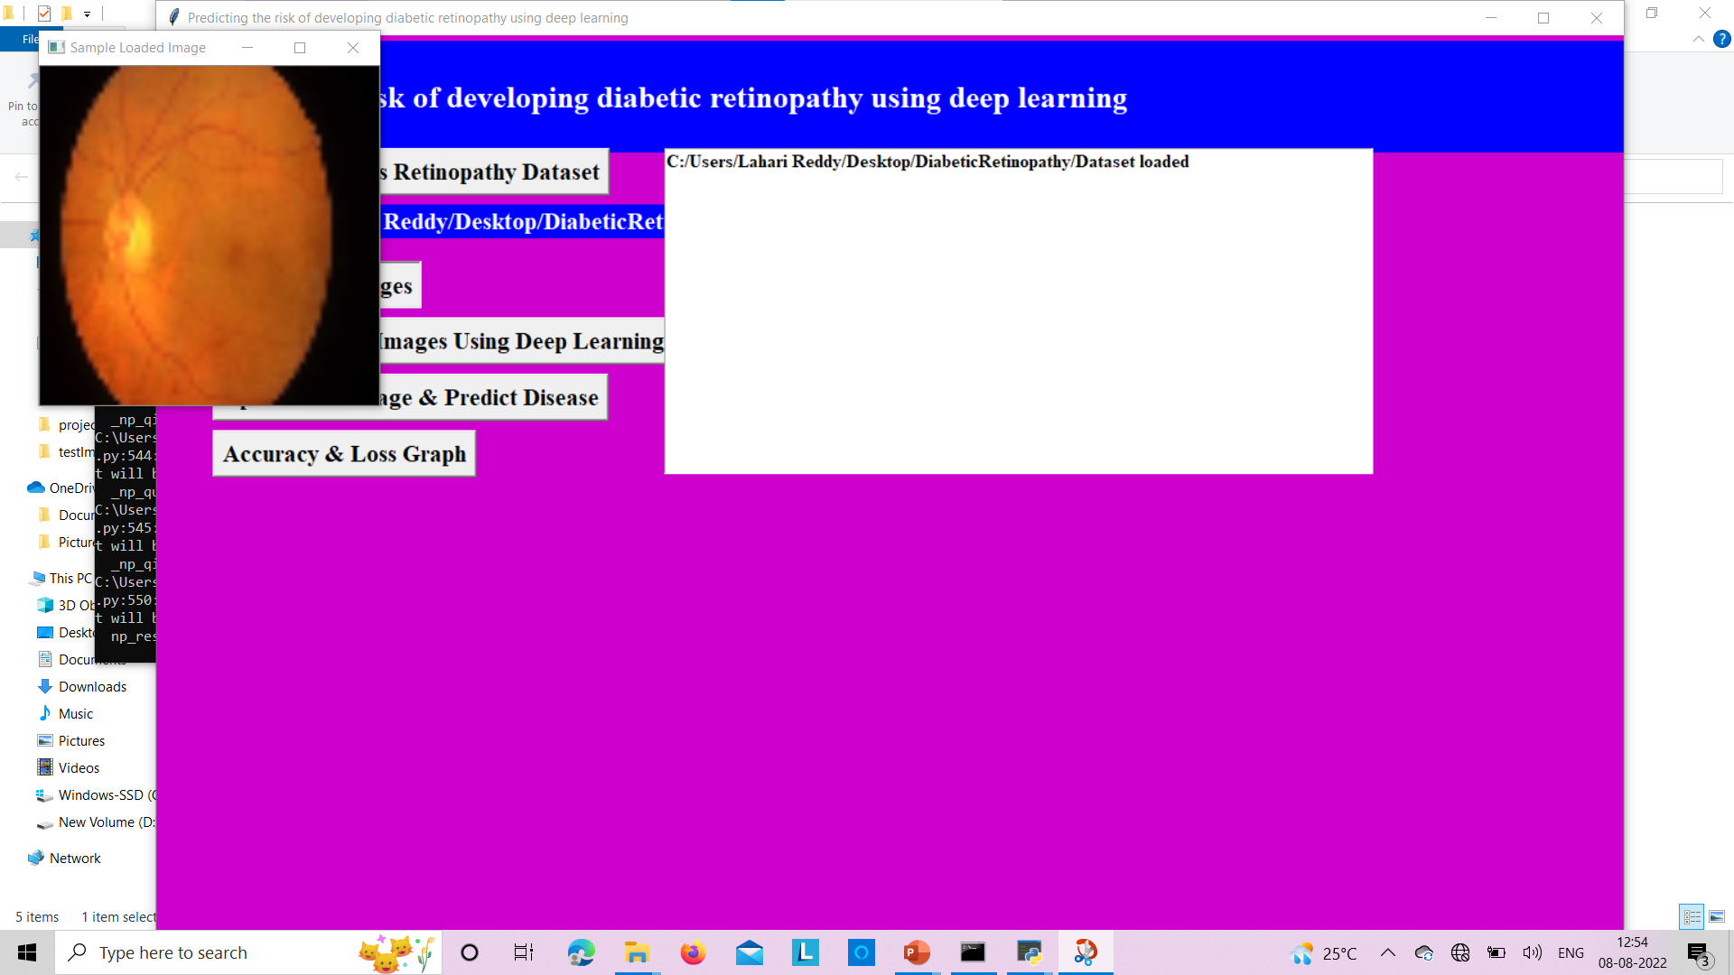

Slide 21
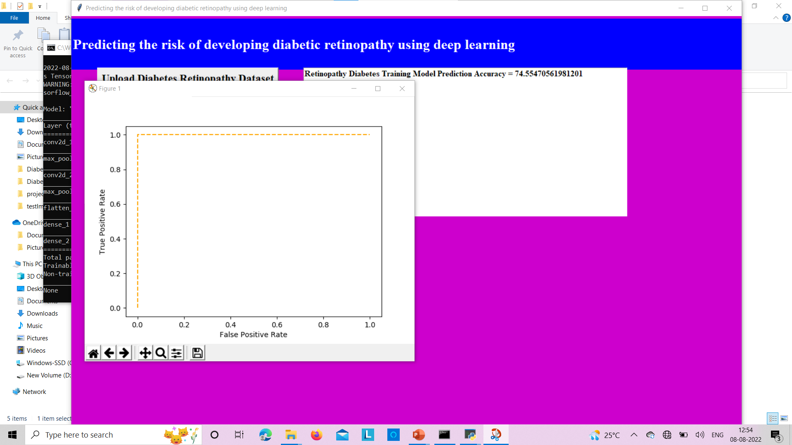
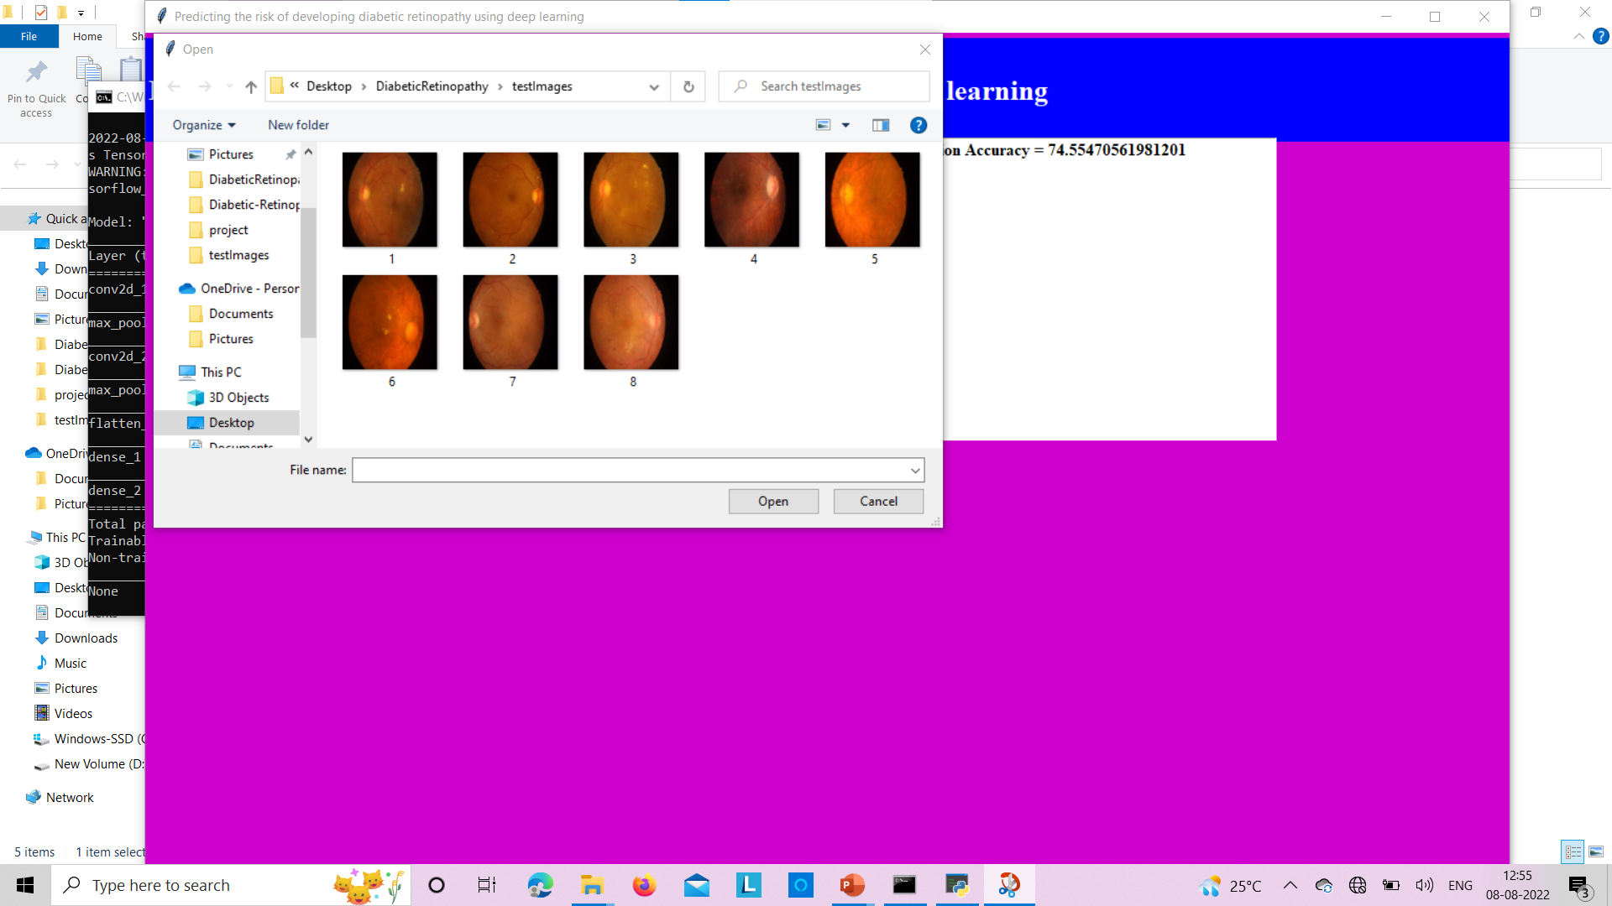

Slide 22
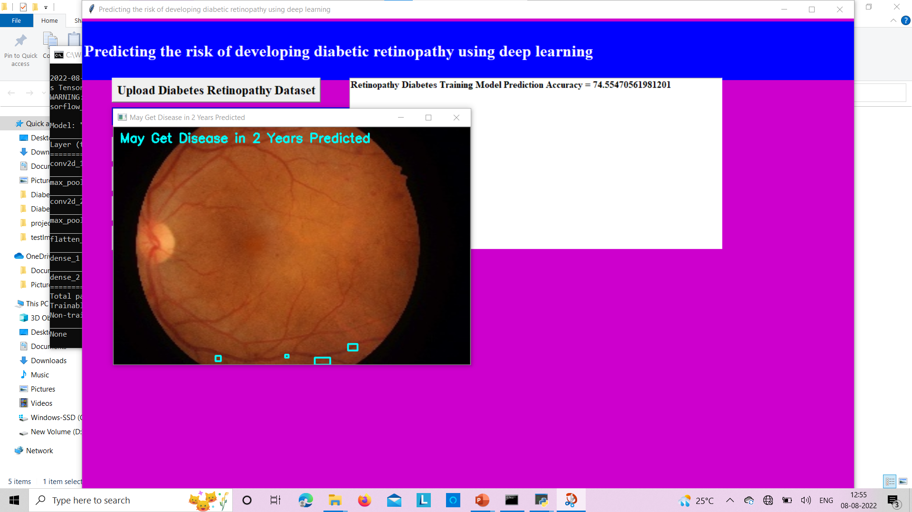
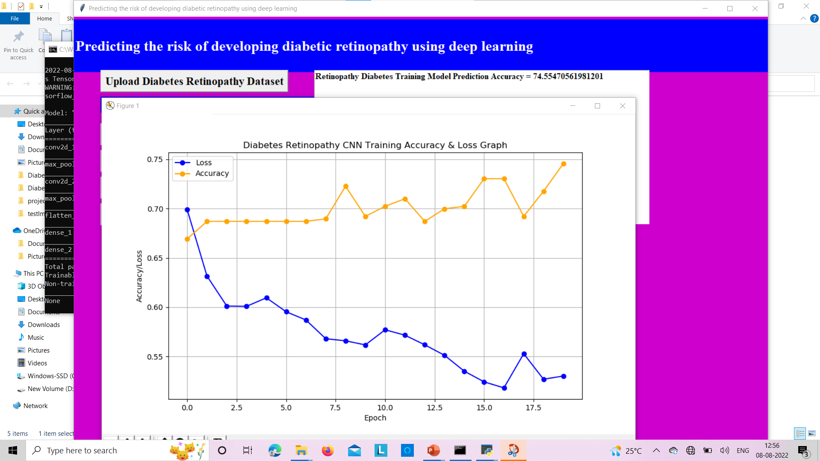
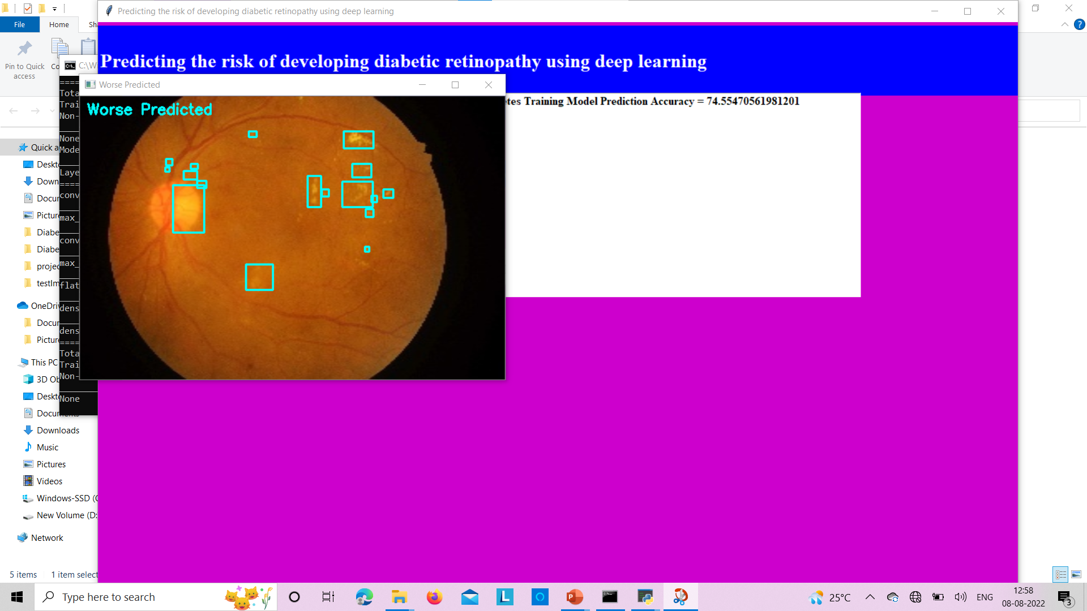

Slide 23
Conclusion:-
Our deep-learning system can provide a more accurate personalised risk assessment to optimise screening intervals; patients at high risk can be followed up frequently to ensure early detection, whereas patients at low risk could be followed up less frequently to reduce the screening burden shared by patients, clinicians, and the health-care system. In our study the patients at the highest risk developed diabetic retinopathy at a rate exceeding 80%, whereas patients at the lowest risk had a less than 5% chance of developing diabetic retinopathy. However, the specific cutoffs for defining high or low risk status and corresponding interventions will need to be studied in future work and probably be tailored to the local resource availability and practice patterns. Other potential uses of the deep-learning system revolve around targeted interventions.
Future scope:-
Future studies could increase the effectiveness of interventions tailored to progression risk (eg, screening intervals) towards improving health outcomes and reducing cost.

Slide 24
THANK YOU

